Slide 1
Medzmate 1.0 Team Members: Juan C. Correa, Pedro Montero Product Owner: Peter Dickson Instructor: Masoud Sadjadi School of Computing and Information Sciences Florida International University
Senior Project Final Presentation Fall 2015
December 11, 2015
Notes:
Greet your audience, thank them for attending your presentation, introduce yourself, introduce your project, introduce your team members, and quickly indicate what each of you did in a high-level manner, and put more emphasis on your part/contribution.

Slide 2
Problem definition
Whole Project:
Medzmate is a revolutionary drug dispenser intented to improve the dispensing process in the pharmaceutical and medical industries.
It can carry up to 10 different pills and provide a constant supply for more than a month without refills.
It dispenses only the right medications at the right time.
Supports real time alerts and notifications.
The software solution consists of a mobile application and a scheduler process running in the Medzmate Station.
My Part:
Design and develop the process running within the Medzmate Station.
Notes:
Introduce the problem that the whole project tackles and stay focused on the parts that you have been working. Indicate if there is an existing previous system, enumerate its problems/limitations, etc.

Slide 3
Project Management
11 days
Plan/Setup
8/28/2015 - 9/11/2015
20 days
Med Info
9/12/2015 - 10/9/2015
3 days
Login
10/9/2015 - 10/13/2015
12 days
Data Trans
10/14/2015 - 10/29/2015
11 days
Patient Info
10/23/2015 - 11/6/2015
6 days
Global Config
11/7/2015 - 11/16/2015
5 days
Alerts
11/16/2015 - 11/20/2015
6 days
Log off
11/20/2015 - 11/28/2015
11 days
Final Testing
11/20/2015 - 12/4/2015
Sprint 2
Sprint 4
Spint 6
9/25/2015
10/22/2015
11/20/2015
Sprint 1
Sprint 3
Sprint 5
Sprint 7
9/11/2015
10/9/2015
11/6/2015
12/4/2015
2015
Aug
Sep
Oct
Nov
Dec
2015
Today

Slide 4
Requirements: User Stories
Add new medicine information
Add new medicine detailed information
App-Station Pharmacist Login
Add a page to connect to a Medzmate given a unique id
User should confirm the entered medicine detailed information
Notes:
4. Requirements:
4.1. User stories implemented (one or more slides).
4.2. UML use cases and the use case diagram for the implemented use cases (one or more slides).
4.3. UML sequence diagrams for the implemented use cases.

Slide 5
Requirements: User Stories
Main Screen
Patient Information
Settings Screen
App: Log Off
Test and Refactor
Notes:
4. Requirements:
4.1. User stories implemented (one or more slides).
4.2. UML use cases and the use case diagram for the implemented use cases (one or more slides).
4.3. UML sequence diagrams for the implemented use cases.

Slide 6
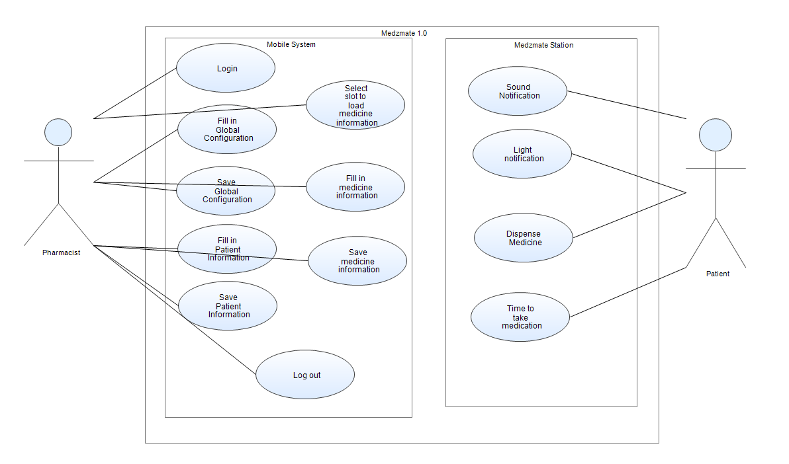
Requirements: Use Cases
Notes:
4. Requirements:
4.1. User stories implemented (one or more slides).
4.2. UML use cases and the use case diagram for the implemented use cases (one or more slides).
4.3. UML sequence diagrams for the implemented use cases.

Slide 7
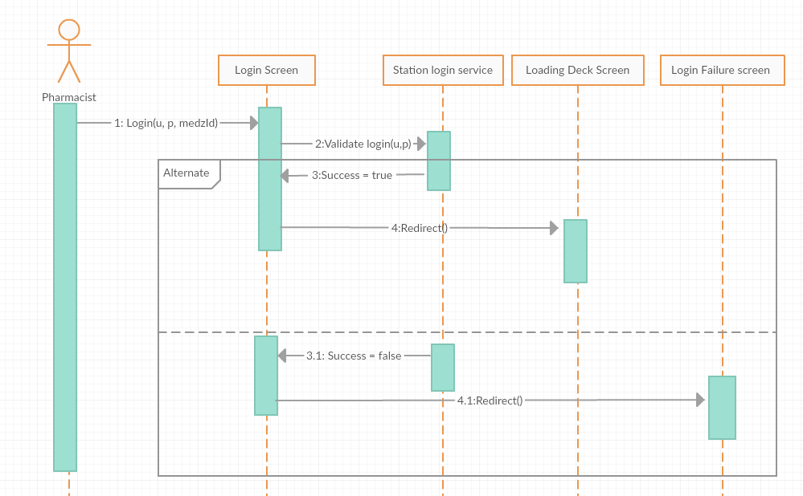
Requirements: Sequence Diagrams
Notes:
4. Requirements:
4.1. User stories implemented (one or more slides).
4.2. UML use cases and the use case diagram for the implemented use cases (one or more slides).
4.3. UML sequence diagrams for the implemented use cases.

Slide 8
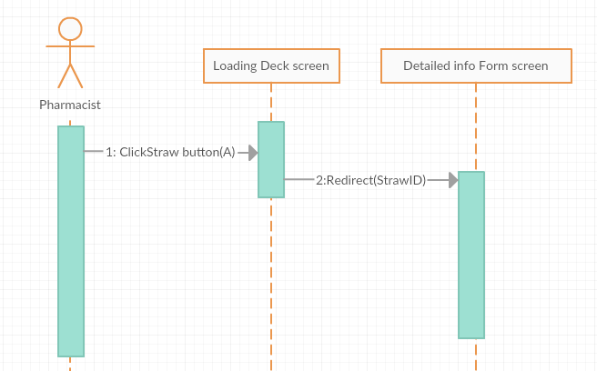
Requirements: Sequence Diagrams
Notes:
4. Requirements:
4.1. User stories implemented (one or more slides).
4.2. UML use cases and the use case diagram for the implemented use cases (one or more slides).
4.3. UML sequence diagrams for the implemented use cases.

Slide 9
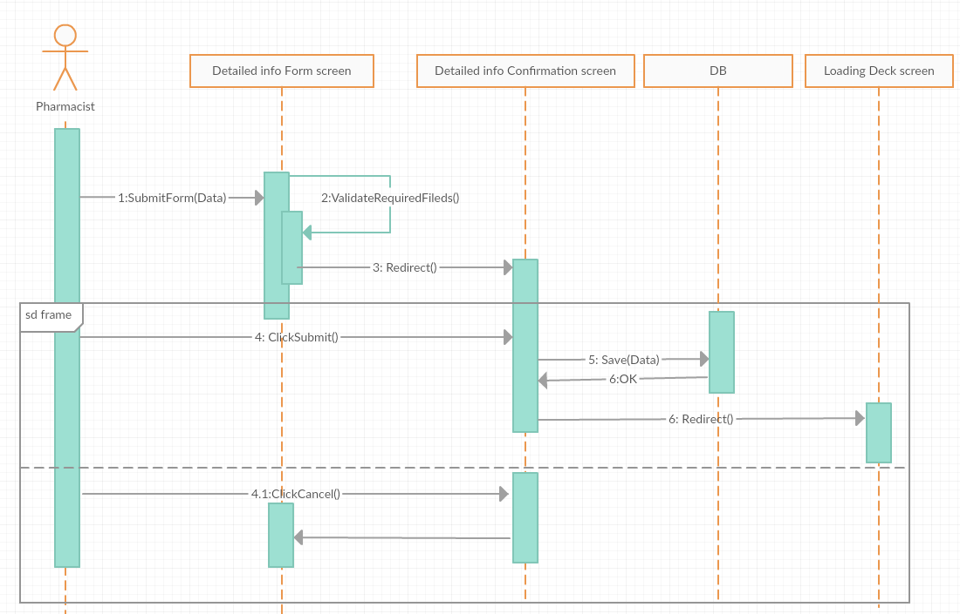
Requirements: Sequence Diagrams
Notes:
4. Requirements:
4.1. User stories implemented (one or more slides).
4.2. UML use cases and the use case diagram for the implemented use cases (one or more slides).
4.3. UML sequence diagrams for the implemented use cases.

Slide 10
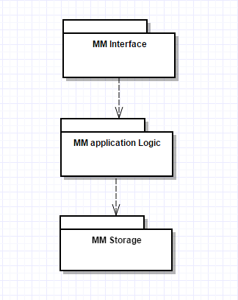
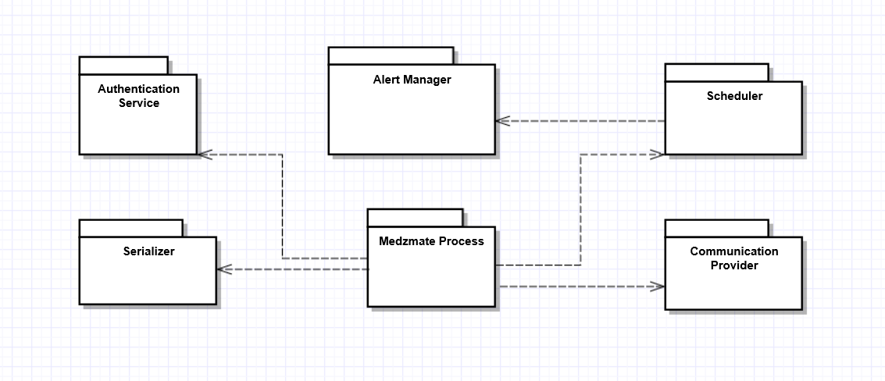
System Design: Architecture
Medzmate Station Component based architecture.
Medzmate 3-tier Architecture
Notes:
5. System design:
5.1. System decomposition; identify the architecture patterns used (one slide).
5.2. System deployment – h/w and s/w requirements (one slide).
5.3. Persistent data design (one slide).
5.4. Security/Privacy (one slide).

Slide 11
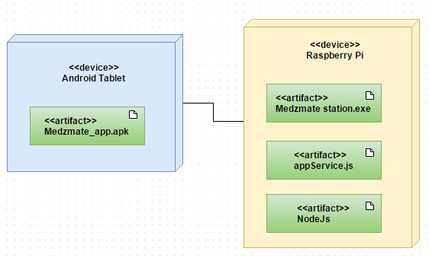
System Design: Deployment
Notes:
5. System design:
5.1. System decomposition; identify the architecture patterns used (one slide).
5.2. System deployment – h/w and s/w requirements (one slide).
5.3. Persistent data design (one slide).
5.4. Security/Privacy (one slide).

Slide 12
System Design
Persistent data design
Format: JSON files.
Storage: Raspbian file system.
Storage: Android file system.
Security/Privacy
Initial version Medzmate 1.0 will not take in consideration security as a paramount feature.
Notes:
5. System design:
5.1. System decomposition; identify the architecture patterns used (one slide).
5.2. System deployment – h/w and s/w requirements (one slide).
5.3. Persistent data design (one slide).
5.4. Security/Privacy (one slide).

Slide 13
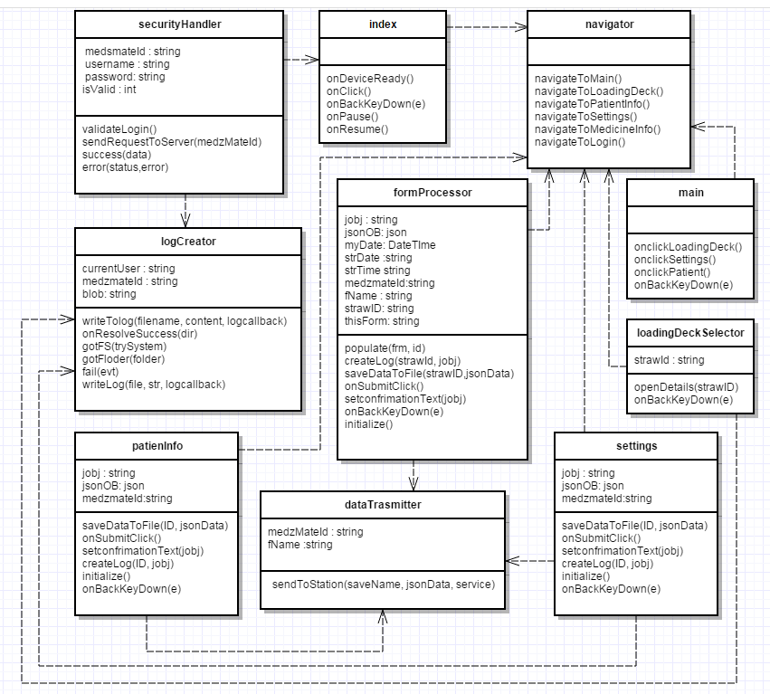
Class Diagram
Notes:
6. Detailed design:
6.1. Minimal class diagram. Identify the design patterns used (one or more slides).
6.2. State machine for the main control object or the most important object of the implemented uses cases (one or more slides).
6.3. Main algorithm used related to an implemented use case described above (one or more slides).

Slide 14
Design Patterns
Behavioral Patterns
Observer or Publish-Subscribe
Interpreter
Iterator
Structural Patterns
Facade
Notes:
6. Detailed design:
6.1. Minimal class diagram. Identify the design patterns used (one or more slides).
6.2. State machine for the main control object or the most important object of the implemented uses cases (one or more slides).
6.3. Main algorithm used related to an implemented use case described above (one or more slides).

Slide 15
Main algorithms
Scheduler algorithm()
WHILE (true)
IF IsTime() THEN ThrowDispensingEvent()
END
IsTime ()
FOREACH straw s
IF s.DispensesOnTime( getComputerTime())
RETURN TRUE
ELSE RETURN FALSE
END
Notes:
6. Detailed design:
6.1. Minimal class diagram. Identify the design patterns used (one or more slides).
6.2. State machine for the main control object or the most important object of the implemented uses cases (one or more slides).
6.3. Main algorithm used related to an implemented use case described above (one or more slides).

Slide 16
Main algorithms
Recursive descent parser algorithm:
JSON ::= ‘[‘ PropertyArray
PropertyArray::= Property Properties
Properties ::= ‘,’ Property Properties | ‘]’
Property ::= ‘{‘ NameValuePair
NameValuePair ::= ‘ “name” :’ alphanumeric ‘,’ ‘ “value” :’ alphanumeric ‘}’
Notes:
6. Detailed design:
6.1. Minimal class diagram. Identify the design patterns used (one or more slides).
6.2. State machine for the main control object or the most important object of the implemented uses cases (one or more slides).
6.3. Main algorithm used related to an implemented use case described above (one or more slides).

Slide 17
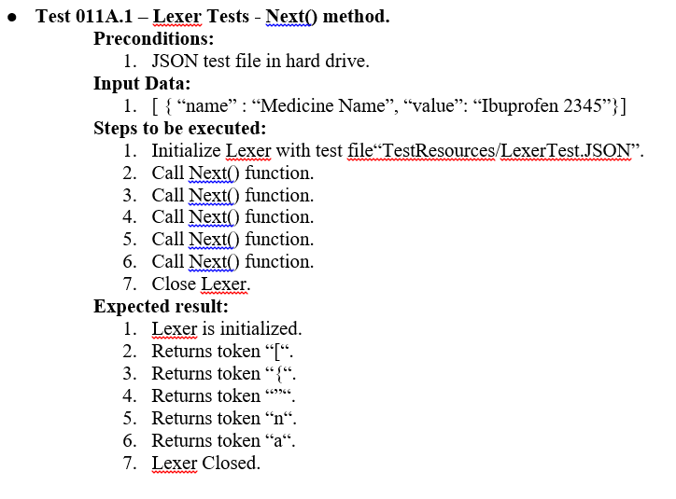
Test Suites and Test Cases
Notes:
7. Test Suites and Test Cases (one sunny day and one rainy day) for the use case represented in part (5) above (2 slides).
7.1 One sunny day and one rainy day for the implemented use cases (one or more slides).
7.2 Automated test scripts for the implemented use cases (one or more slides).

Slide 18
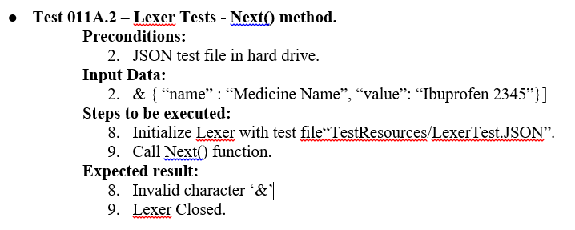
Test Suites and Test Cases
Notes:
7. Test Suites and Test Cases (one sunny day and one rainy day) for the use case represented in part (5) above (2 slides).
7.1 One sunny day and one rainy day for the implemented use cases (one or more slides).
7.2 Automated test scripts for the implemented use cases (one or more slides).

Slide 19
Summary
Medzmate 1.0 solution consists of two main software applications
Medzmate Mobile Application & Medzmate Station
Medzmate Mobile Application will be the configuration tool used by health care providers to set up each Medzmate Station with the prescribed schedule.
Medzmate Station will dispense the right medications at the right time according to the prescribed schedule.
Notes:
Summarize your contribution
Include your contact information
Ask if anyone has any questions for you.
Thank your audience

Slide 20
Q&A
Contact Information:
Notes:
Summarize your contribution
Include your contact information
Ask if anyone has any questions for you.
Thank your audience

Slide 21
Thank You!
Notes:
Summarize your contribution
Include your contact information
Ask if anyone has any questions for you.
Thank your audience

